Slide 1
European Colonization In AfrIca (The new imperialism)
Created, Edited, Made and Conceived by the Great and Fabulous Everett Jiang

Slide 2
Why African Colonization?
19th Century experienced Christian Revival. Europeans wanted to expand the religion.
New technology allowed the Europeans to explore deeper into the vastly unexplored continent. Ex: Quinine and the flintlock rifle
The White Man’s Burden/Social Darwinism/Racism
Explorers such as David Livingston, Mungo Park, Richard Burton…etc wanted to explore.

Slide 3
Why they really wanted Africa
Africa was an untapped market (Lenin’s theory 1917)
Africa could serve as a market for low end goods at high prices
Africa bears large quantities of gold, diamonds, silver, iron, palm oil, rubber, and copper.
European Countries are extremely similar to a group of Middle School teens. They are competitive and will do anything to above the rest, including a race for foreign territories. (Robinson and Gallaghar)

Slide 4
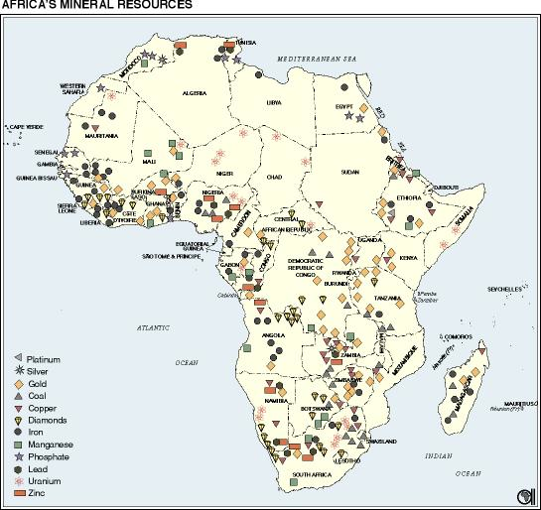

Slide 5
Benefits of Africa
European technology such as medicine increased the lifespan of Africans
Europeans introduced modern social infrastructure
A small portion of the population in Africa gained high end education. Christianity brought along education.

Slide 6
Not So benefits…
European colonization corroded many existing African values and destroyed some social relationships.
African people were treated as inferior, working harder and longer for less pay.
Europeans divided up Africa into plots of land with no regard for CRIPES, thus the boundaries created were bound to create conflict later on. Ethnic cleansing and civil wars resulted (Sudan? Congo? Kony?)

Slide 7
The scramble for africa
Before 1880, European nations had little of Africa. However, intense competition (Think Business Plan. More=Better) gave way to a divided Africa.
The land was divvied up in the Berlin Conference 1884-1885
Scramble prompted by King Leopold II of Belgium (Took Congo)

Slide 8
West Africa
Growing tensions in West Africa between European nations and local governments led to the loss of African independence.
Great Britain annexed the west coast, naming it the Gold Coast and named Nigeria Protectorate
  This coast was at first very popular for the slave trade, in exchange for weapons and textiles from Europe
  Later on after the emancipation of slaves, it was a source of raw materials
  This growing market led Europeans to push for more settlements

Slide 9
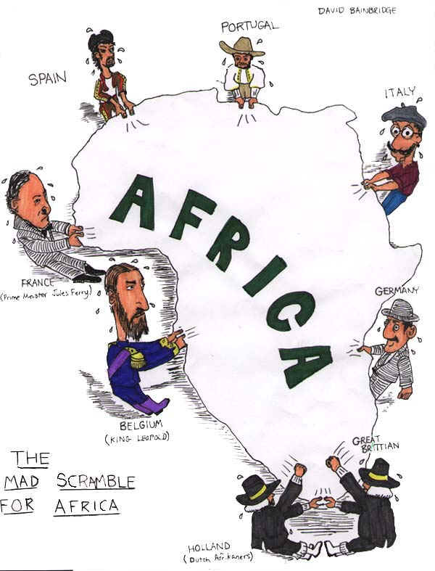

Slide 10
North Africa
Steamboats made a great contribution, though had to be disassembled then reassembled for overland journeys.
French Funded the Suez Canal. The British viewed it as a lifeline and named Egypt a Protectorate of Great Britain.
The Suez ruined Egypt

Slide 11
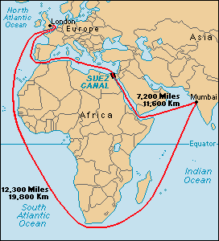
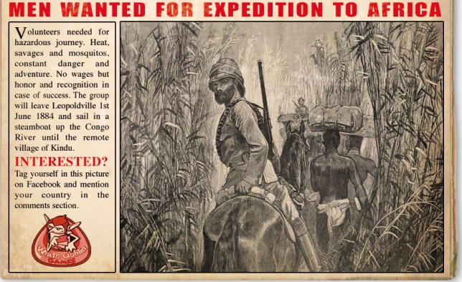

Slide 12
Central and East Africa
Germany was under pressure to gain territories
1884-Berlin Conference (mentioned before). No African delegates were present.

Slide 13
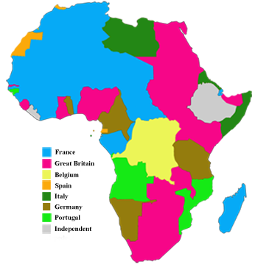
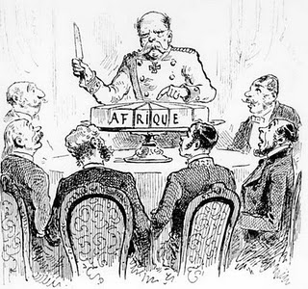

Slide 14
Southern africa
The European Powers came quickly to Dominate
In South Africa, the British and the Dutch fought for dominance
The Boers or Afrikaners were descendants of Dutch settlers since 1600
Boer Wars 1880 and 1899
  Detested British Rule. Migrated to coastal areas, displacing locals
  Frequently encountered Zulus in Conflict. Shaka, a Zulu leader proved troublesome until the British annialated them.
  The British also imprisoned 120,000 Boer Women and Children where 20,000 died. The Boers surrender to the British.

Slide 15
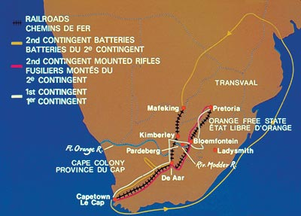
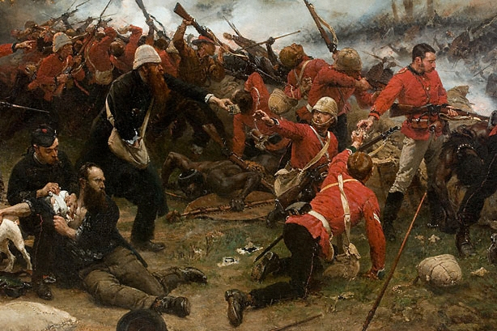

Slide 16
Colonial System
Purpose of Colony was to utilize local land and labor
Each nation varied
  British used Indirect Rule
  French used Direct Rule
    French Industry depended on the supplies coming from the colonies

Slide 17
Effects of Imperialism
By 1914, Africa was divided up completely into European territories
The failed resistances were squashed by professional forces
Africans of a lower class was exploited as cheap labor
Segregation Europeans felt superior (Darwinism)
The Africans as expected were very unhappy
  Had feelings of resentment towards the European man

Slide 18
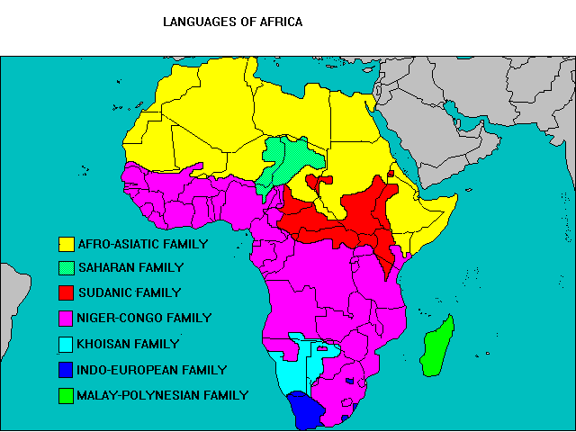
Reason enough?

Slide 19
Nationalism in Africa
Africans educated in the Western system became frustrated that the Europeans were not doing what they said
  Democracy, equality, freedom…
Africans respected European culture, but resented the oppression
  Political parties developed in Africa as well as an urge to end colonial rule
  Some uprisings but were quickly quashed (Maji Maji 1906 suppressed by Germans for example)

Slide 20
The end
Great links
  http://www.youtube.com/watch?v=Z-YuLzzHQlg
  http://www.saylor.org/site/wp-content/uploads/2011/12/HIST252-Subunit-2.3.2-Why-Did-Europe-Colonize-FINAL.pdf
  http://www.youtube.com/watch?v=alJaltUmrGo
  http://www.youtube.com/watch?v=CM2Xa12YsX0

Slide 21
sources
http://africanhistory.about.com/od/eracolonialism/a/ScrambleWhy.htm
http://www.tensionsofeurope.eu/www/en/files/get/file4.pdf
http://www.the-map-as-history.com/maps/5-history-europe-colonization.php
http://www.sparknotes.com/history/european/1871-1914/section5.rhtml
http://moleboi.wordpress.com/2011/03/02/why-did-europeans-expand-into-america-africa-and-asia-between-1415-and-1715/
http://courses.wcupa.edu/jones/his312/lectures/19thcent.htm
http://www2.sunysuffolk.edu/westn/imperialism.html

